Slide 1
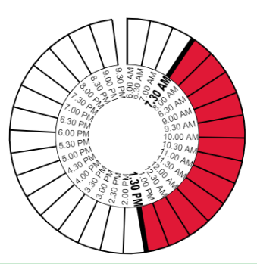
PRIVATE INSTITUITION TIME MANAGEMENT
By: S.Manasan

Slide 2

Problem: Unable to find the right time for a private collabrative event
Solution:
A mangement system to analyse/report the avaliable time of students/members

Slide 3
Technologies Used in this web app
HTML
Vanilla JS
PHP
MySql

Slide 4
Use Cases
Can be used in private tutions to find appropriate time
Can be used in Companies to find the most suitable time for a meeting
Can be used to get a time for a get-together

Slide 5
Profit Model
Layouts/Ads
Subscription
Data Market

Slide 6
Thank You

